Slide 1

SEASONS
We will explain why different seasons are experienced on Earth

Slide 2
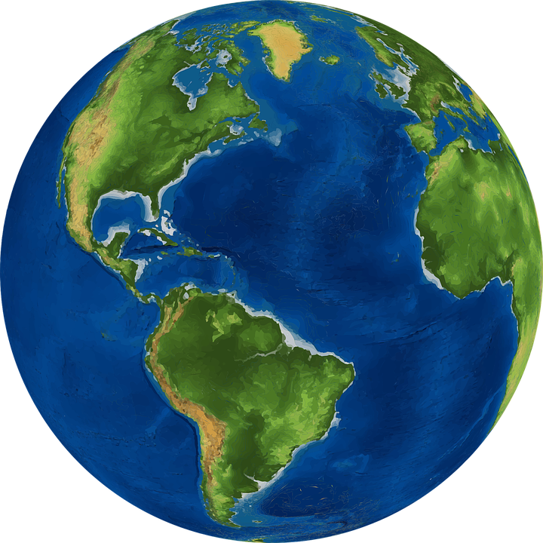
On your whiteboards, draw a diagram showing night and day on Earth. Include the sun in your diagram.

Slide 3
Repeat the opposite word/phrase.
ORBIT
PATH AROUND AN OBJECT

Slide 4
Repeat the opposite word/phrase.
AXIS
LINE OF ROTATION

Slide 5
Repeat the opposite word/phrase.
ROTATION
SPIN ON AXIS
1 DAY OR 24 HOURS

Slide 6
Repeat the opposite word/phrase.
REVOLUTION
SINGLE ORBIT
1 YEAR OR 365.25 DAYS

Slide 7
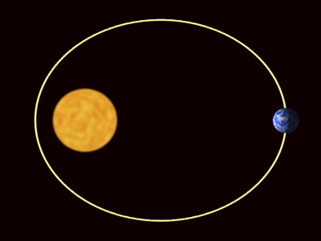
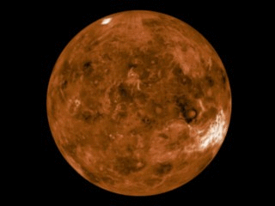
Which of the diagrams show a rotation?
Which of the diagrams show a revolution?
A B

Slide 8
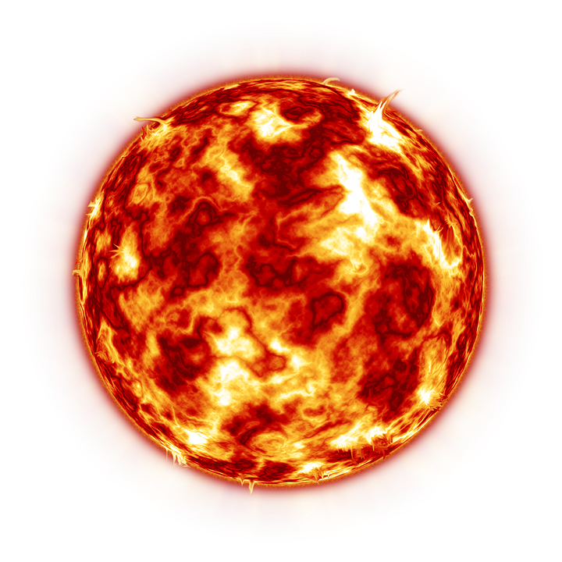
Match the word with its meaning.
Axis
Rotation
Revolution
Solar
Related to the sun
The spinning on an axis
The line of rotation
A single orbit

Slide 9
We will explain why different seasons are experienced on Earth
TRACK WITH ME
READ WITH ME
We will define axis.
We will define tilt.
We will use diagrams to model₁ the movements of the Earth during the seasons.
Vocabulary
1 - to produce a representation (e.g. drawing)
DECLARE THE OBJECTIVE
Read the learning objective to your partner.
Notes:
Learning Objectives contain concepts (nouns, big ideas), skills (verbs, measurable behaviours) and sometimes context (restricting or targeting conditions).
●Example: Students will be able to describe the concept of density and apply it to floating and sinking.
●
Success criteria are specific measurable outcomes that if met mean that the student has met the learning objective.
Examples:
•Students will be able to compare densities of substances using mass and volume.
•Students will be able to identify whether a solid or liquid will float or sink in a liquid based on their densities.

Slide 10

We will explain why different seasons are experienced on Earth
What seasons do you know?
What weather can we observe during these seasons?
Season | Weather observations
STUDENTS REMEMBER
Students, you already know that we observe different weather at different times during the year.

Slide 11
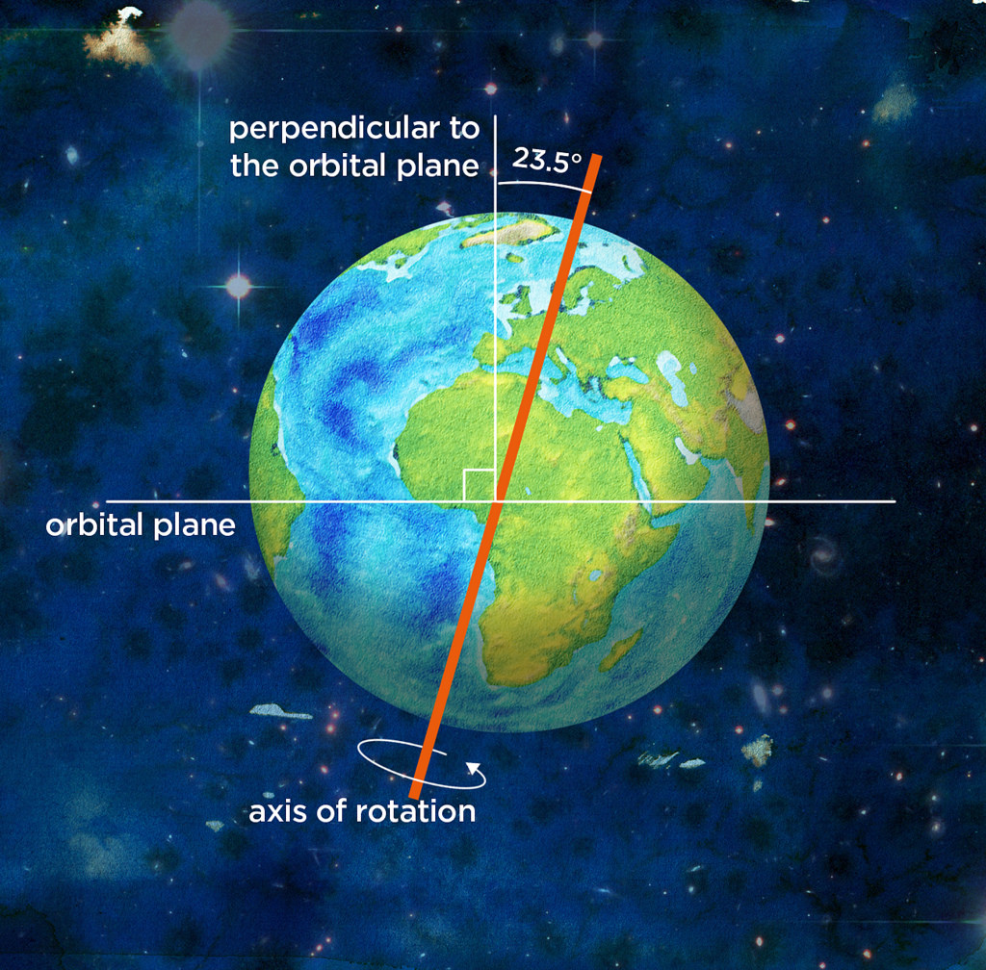
We will explain why different seasons are experienced on Earth
The Earth’s axis₁ is not straight, it’s on a tilt₂.
As Earth revolves around the sun, parts of the Earth are closer to the sun and parts are further away.
The hemisphere₃ closer to the sun experiences summer and the hemisphere further away experiences winter.
VOCABULARY
1 - line a planet spins around 2 - leaning position 3 - half of a sphere
CHECK FOR UNDERSTANDING
Right now, the weather is getting warmer as we get closer to summer. We are in the southern hemisphere. Are we getting closer to the sun or further away? Explain your answer.

Slide 12
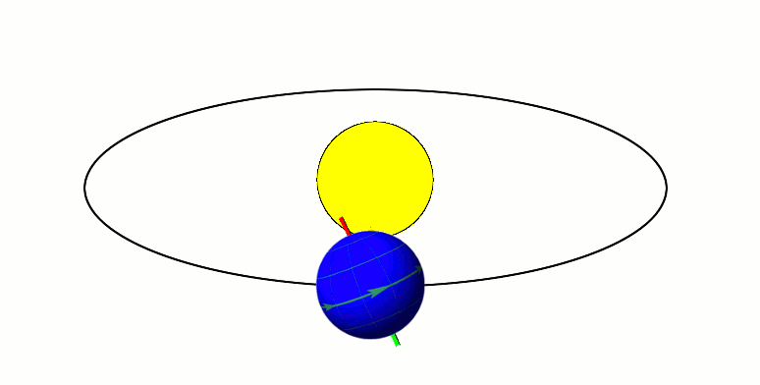
We will explain why different seasons are experienced on Earth
The hemisphere₁ closer to the sun experiences summer and the hemisphere further away experiences winter.
Sept
Dec Jun
Mar
CHECK FOR UNDERSTANDING
If the northern hemisphere is experiencing winter what season is it in the southern hemisphere? Explain your answer.
VOCABULARY
1 - half of a sphere

Slide 13
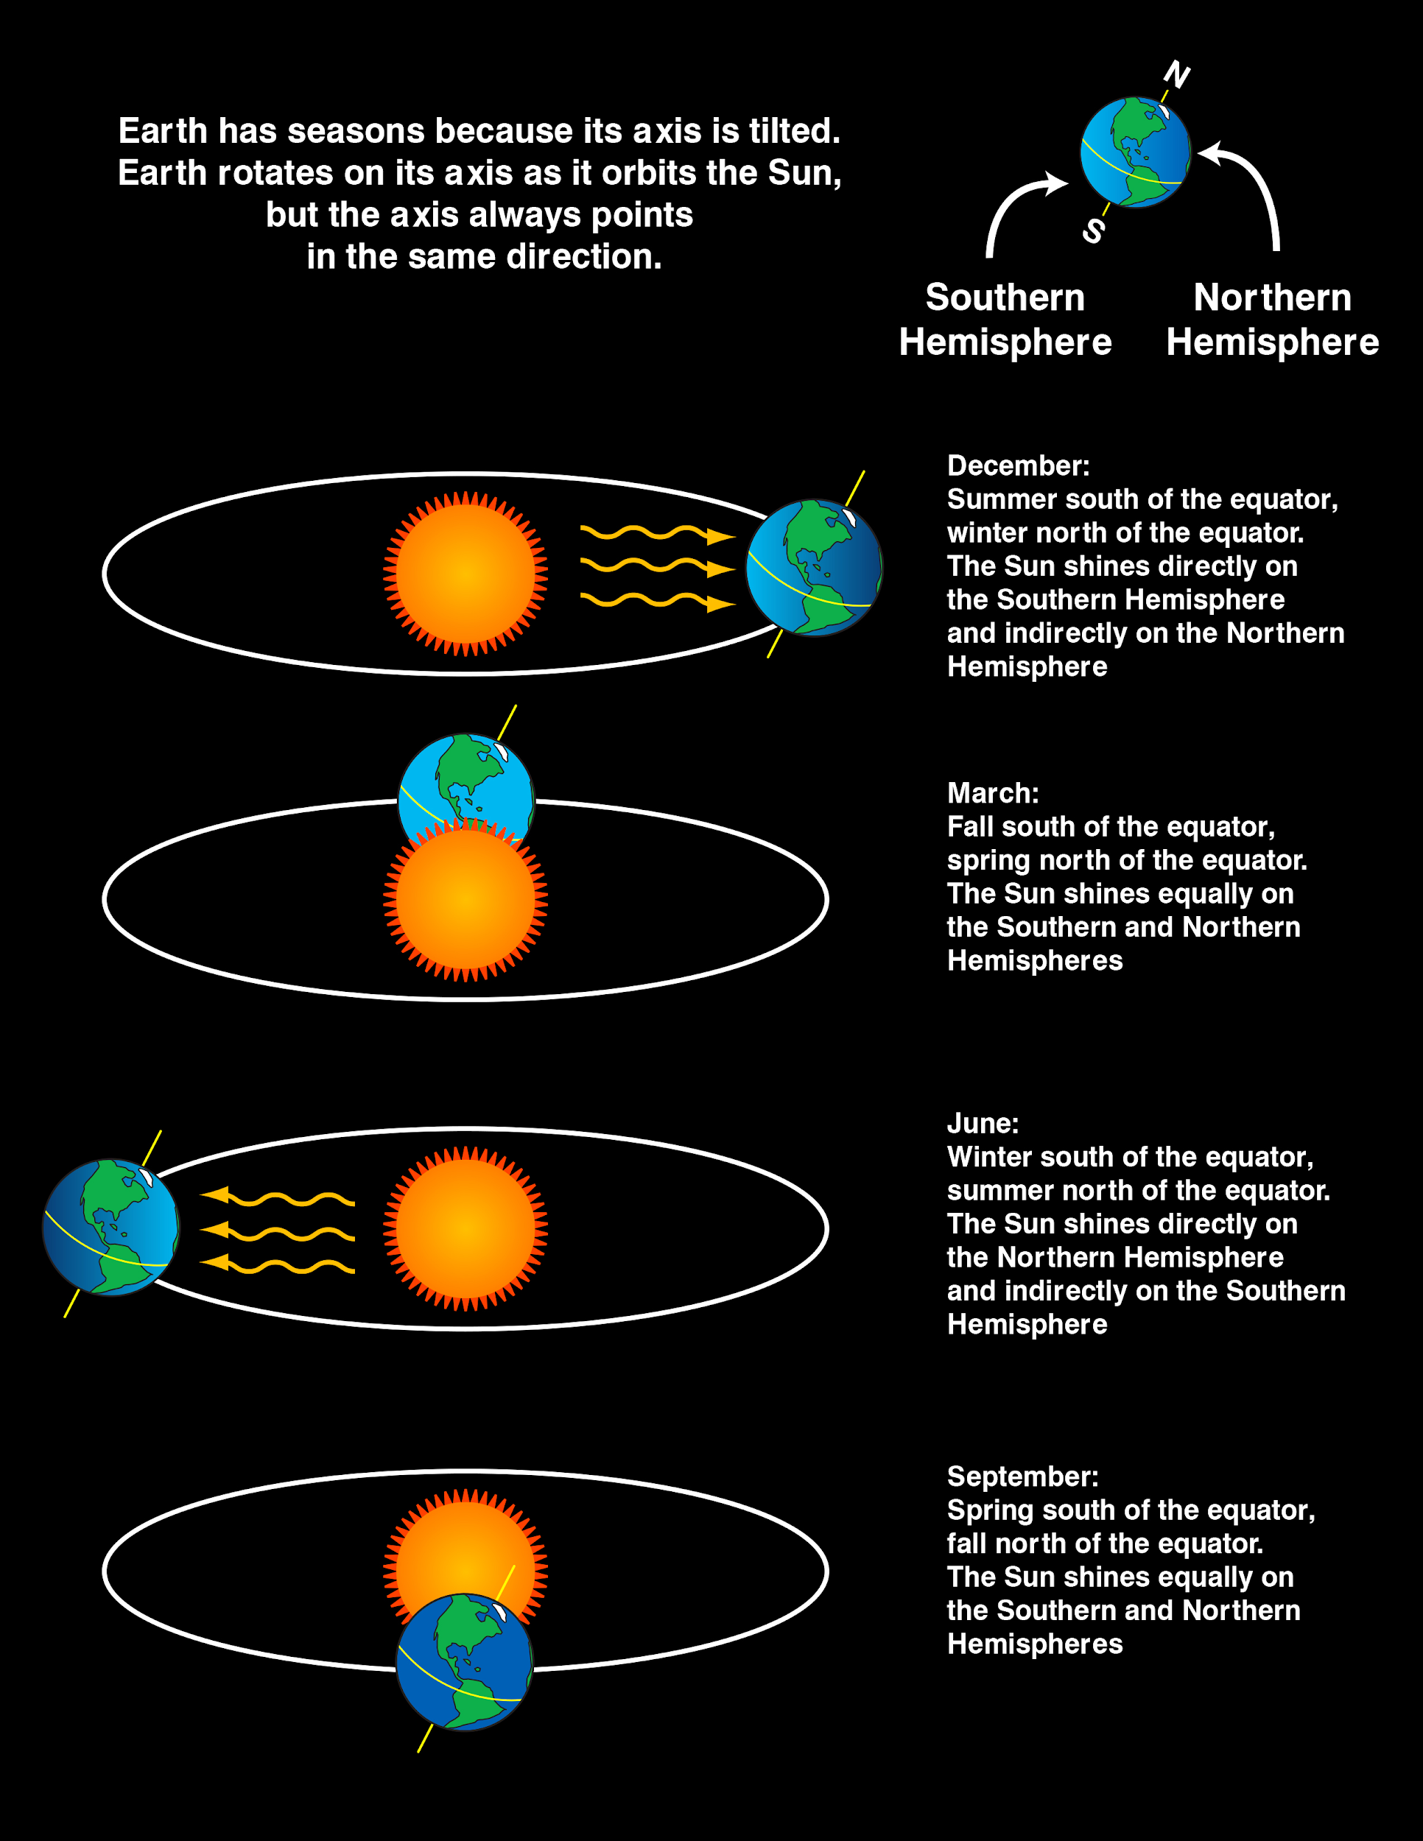
We will explain why different seasons are experienced on Earth
The hemisphere₁ closer to the sun experiences summer and the hemisphere further away experiences winter.
DECEMBER
MARCH
JUNE
SEPTEMBER
Month | Northern Hemisphere | Southern Hemisphere
December | Winter | Summer
March | Spring | Autumn
June | Summer | Winter
September | Autumn | Spring
CHECK FOR UNDERSTANDING
What would happen if the Earth’s axis₂ wasn’t on an angle?
VOCABULARY
1 - half a sphere 2 - the line that a planet spins around

Slide 14
We will explain why different seasons are experienced on Earth
Use the diagram to answer the questions below.
CHECK FOR UNDERSTANDING
On your second and third diagrams, can you identify the season of the northern hemisphere? Explain your answer.
Draw a diagram showing the Earth and its tilted axis₁.
Draw a diagram showing the southern hemisphere₂ experiencing summer.
Draw a diagram showing the southern hemisphere₂ experiencing winter.
HINT
Remember that the hemisphere that experiences summer is closer to the sun. The hemisphere that experiences winter is further away from the sun.
VOCABULARY
1 - the line that a planet spins around 2 - half of a sphere

Slide 15
We will explain why different seasons are experienced on Earth
We observe the effects of the seasons each year.
It’s important for us to know why we have seasons.
It can be explained by the Earth’s movement.

Slide 16
We will explain why different seasons are experienced on Earth
The Earth’s axis₁ is on a tilt₂ which explains our seasons.
During one revolution, parts of the Earth are closer and further away from the sun.
The small difference in distance from the sun throughout the year, results in the seasons.
CHECK FOR UNDERSTANDING
If we are experiencing spring, which hemisphere₃ is closer to the sun? Explain your answer.
VOCABULARY
1 - the line a planet spins around 2 - leaning position 3 - half of a sphere

Slide 17
We will explain why different seasons are experienced on Earth
Draw a diagram explaining the seasons experienced on Earth. Include the following:
Sun
Earth
Earth’s axis₁
December, March, June, September
Summer, Autumn, Winter, Spring
HINT
Remember that the hemisphere₂ that experiences summer is closer to the sun. The hemisphere that experiences winter is further away from the sun.
VOCABULARY
1 - line a planet spins around 2 - half of a sphere
Notes:
Please include tasks/questions here rather than just referring to a worksheet. This will save on photocopying and facilitate sharing with other schools.
Try and build tasks/questions which escalate through Bloom’s Taxonomy. This will help with differentiation.

Slide 18
We will explain why different seasons are experienced on Earth
We will describe the axial tilt of the Earth
We will model₁ the movements of the Earth around the sun to explain the seasons
VOCABULARY
1 - to produce a representation (e.g. drawing)
CHECK FOR UNDERSTANDING
Check Success Criteria.

